Slide 1
CMSC 603
High-Performance Distributed Systems
MPI + Slurm
Dr. Preetam Ghosh
Professor
Department of Computer Science
pghosh@vcu.edu

Slide 2

CMSC 603 - HPDS
MPI
MPI + Slurm
  On maple.cs.vcu.edu MPI loaded by default. No Slurm. Use mpirun -np N ./prog
  On athena.hprc.vcu.edu MPI loaded using module load mpi/openmpi-4.1.6
  # MPI process(es) == # Slurm task(s)
  A process may be in turn single-threaded or multi-threaded
  Main parameters of Slurm with MPI:
    --ntasks N (required, to match the number of MPI processes)
    --cpus-per-task N (required, to match the number of threads per process)
    --mem 1G (required, memory allocation for a node, e.g. 1G)
    --nodes N (optional, to enforce a specific number of nodes)

Slide 3
CMSC 603 - HPDS
MPI
Distributed MPI + Slurm
  MPI code (mpi_no_threads.c) and Slurm script (slurm_mpi_no_threads.sh)
  Run as sbatch slurm_mpi_no_threads.sh
int main(int argc, char** argv) {
int process_rank, number_processes, hostname_length;
char hostname[MPI_MAX_PROCESSOR_NAME];
MPI_Init(&argc, &argv);
MPI_Comm_rank(MPI_COMM_WORLD, &process_rank);
MPI_Comm_size(MPI_COMM_WORLD, &number_processes);
MPI_Get_processor_name(hostname, &hostname_length);
printf("Hello from process %d out of %d. Running on node %s\n",
process_rank, number_processes, hostname);
MPI_Finalize();
}
#!/bin/bash
#SBATCH --ntasks 8
#SBATCH --cpus-per-task 1
#SBATCH --mem 1G
#SBATCH --output mpi_no_threads.log
module load mpi/openmpi-4.1.6
mpirun -np $SLURM_NTASKS mpi_no_threads

Slide 4
CMSC 603 - HPDS
MPI
Distributed MPI + OpenMP threads + Slurm
  MPI+OMP code (mpi_openmp_threads.c) and Slurm script (slurm_mpi_openmp_threads.sh)
  Run as sbatch slurm_mpi_openmp_threads.sh
int main(int argc, char** argv) {
int process_rank, number_processes, hostname_length;
char hostname[MPI_MAX_PROCESSOR_NAME];
MPI_Init(&argc, &argv);
MPI_Comm_rank(MPI_COMM_WORLD, &process_rank);
MPI_Comm_size(MPI_COMM_WORLD, &number_processes);
MPI_Get_processor_name(hostname, &hostname_length);
#pragma omp parallel
printf("Hello from process %d out of %d. Thread %d out of %d.
Running on node %s\n", process_rank, number_processes,
omp_get_thread_num(), omp_get_num_threads(), hostname);
MPI_Finalize();
}
#!/bin/bash
#SBATCH --ntasks 8
#SBATCH --cpus-per-task 4
#SBATCH --mem 1G
#SBATCH --output mpi_openmp_threads.log
module load mpi/openmpi-4.1.6
export OMP_NUM_THREADS=$SLURM_CPUS_PER_TASK
mpirun -np $SLURM_NTASKS mpi_openmp_threads

Slide 5
CMSC 603 - HPDS
MPI
Other considerations
  Use --ntasks-per-node M in combination with --nodes N as an alternative to
  --ntasks N*M. However, never use them simultaneously.
  Use %x (job name) and %j (job id) as variables in your Slurm script
    #SBATCH --output %x-%j.log
  To minimize runtime deviations among nodes with significant different ages
  run on the cpu-large partition that only contains AMD nodes of similar age
    #SBATCH --partition=cpu-large

Slide 6
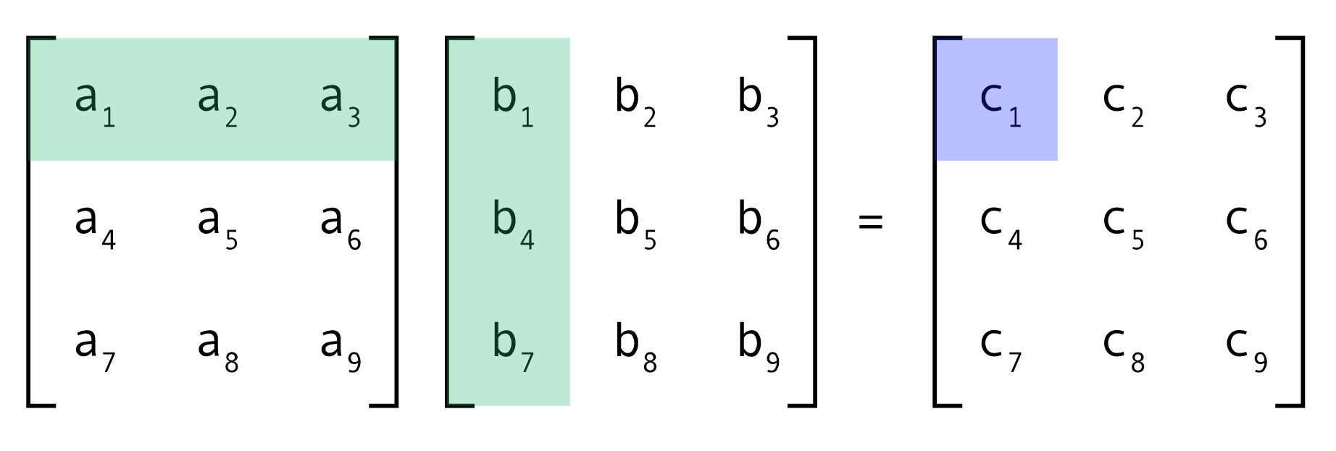
CMSC 603 - HPDS
MPI
Matrix multiplication in MPI with scatter and gather (see matrixmultiplication_mpi.c)
  Matrix C can be resolved in parallel by a number of processes (e.g. per row)
  Matrix A can be scattered. Matrix B can be broadcasted
  Matrix C can be gathered
  OpenMP can be also leveraged to parallelize each process

Slide 7
CMSC 603
High-Performance Distributed Systems
MPI + Slurm
Dr. Preetam Ghosh
Professor
Department of Computer Science
pghosh@vcu.edu

